Slide 1
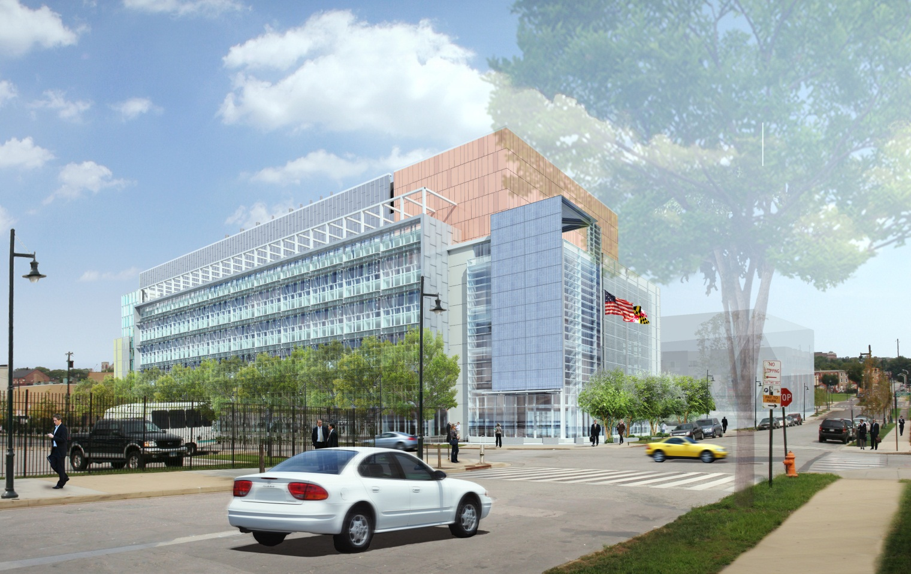
The Maryland Public Health Laboratories
Baltimore, MD
Penn State Architectural Engineering Capstone Project
Greg Tinkoff | Construction Management Option | Advisor: Dr. Robert Leicht

Slide 2
Outline
Building Overview
Project Participants
Introduction
Project Overview
Building Overview
Project Participants
Building Location
Construction Site Plan
Analysis #1: Precast Concrete Structural System
Analysis #2: Virtual Mock-ups for Building Façade System
Analysis #3: Implementation of Alternate Dewatering System
Analysis #4: Value Engineering Stormwater Harvesting System
Conclusion & Recommendations
Acknowledgements
Questions
Building: The Maryland Public Health Laboratories
Building Location: Lot-4 on the Science + Technology Park at Johns Hopkins University, Baltimore, MD.
Building Size: 234,046 Gross S.F.
Number of Stories: 6 Stories + 2 Story Mechanical Penthouse
Occupancy/Function Type: Offices & Medical Research Laboratories
Project Cost: $111,400,000
Dates of Construction: December 19, 2011- April 19, 2014
Project Delivery Method: Design Build
Contract Type: Lump Sun CMc
Developer: Forest City-New East Baltimore Partnership
Owner: Maryland Economic Development Corporation
Occupants: The Maryland Department of Health & Mental Hygiene
Building Designer: HDR, Inc.
Project Management: Jacobs Engineering
General Contractor: Turner Construction Co.

Slide 3
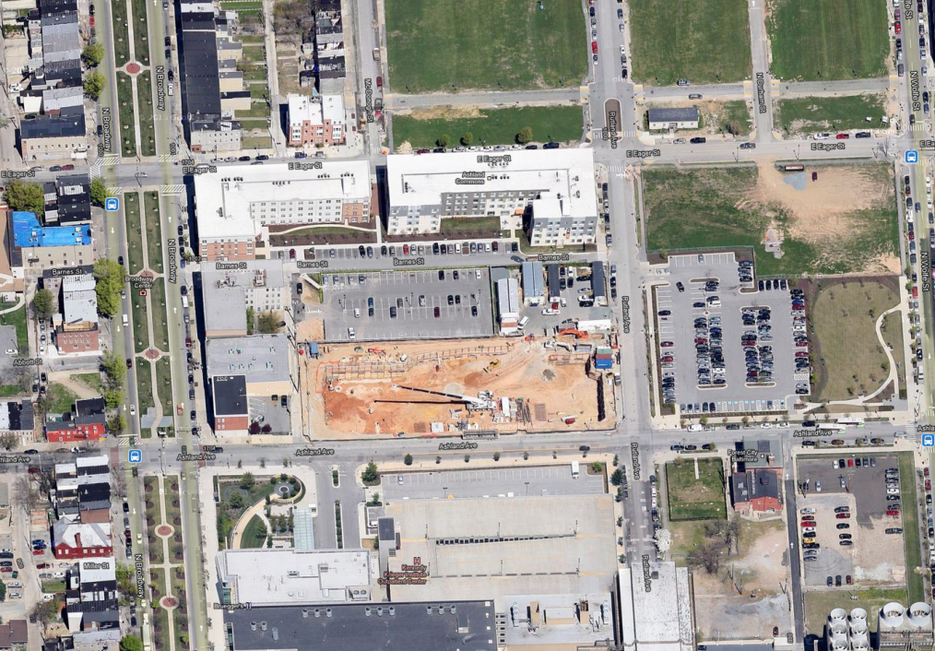
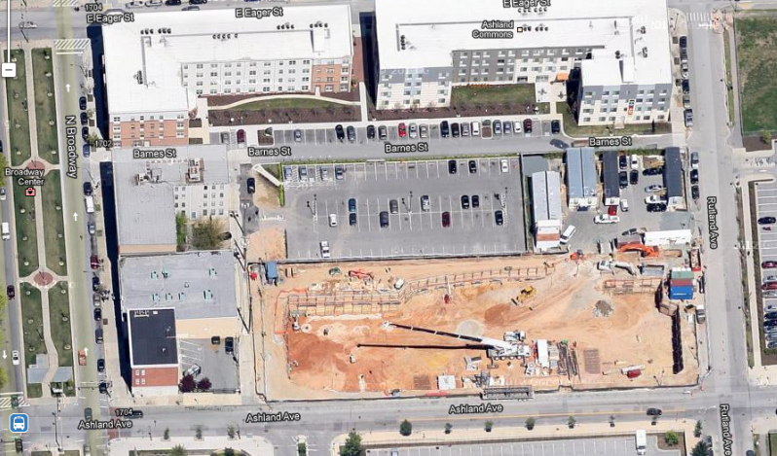
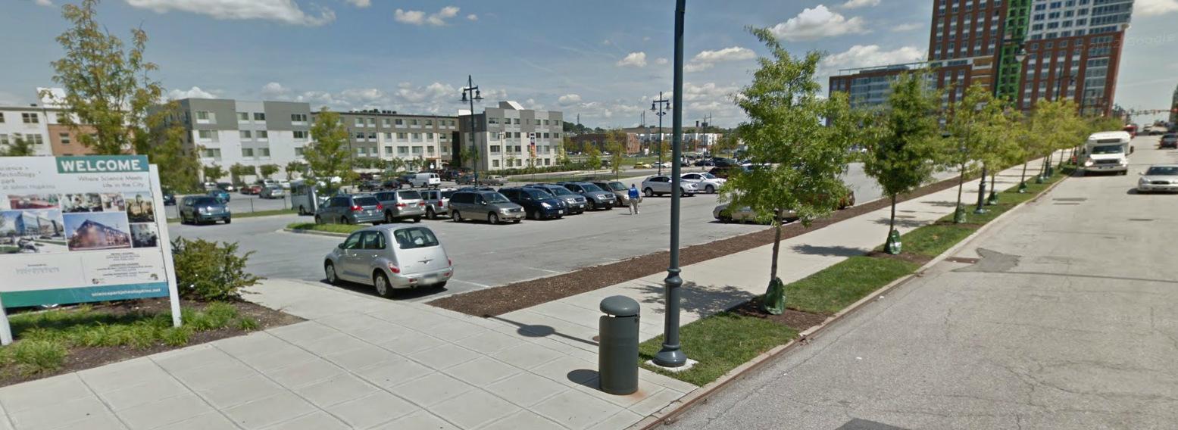
Outline
Building Location
Construction Site Plan
Introduction
Project Overview
Building Overview
Project Participants
Building Location
Construction Site Plan
Analysis #1: Precast Concrete Structural System
Analysis #2: Virtual Mock-ups for Building Façade System
Analysis #3: Implementation of Alternate Dewatering System
Analysis #4: Value Engineering Stormwater Harvesting System
Conclusion & Recommendations
Acknowledgements
Questions
1710 Ashland Avenue, Baltimore, Maryland, United States

Slide 4
Analysis #1: Precast Concrete Structural System

Slide 5
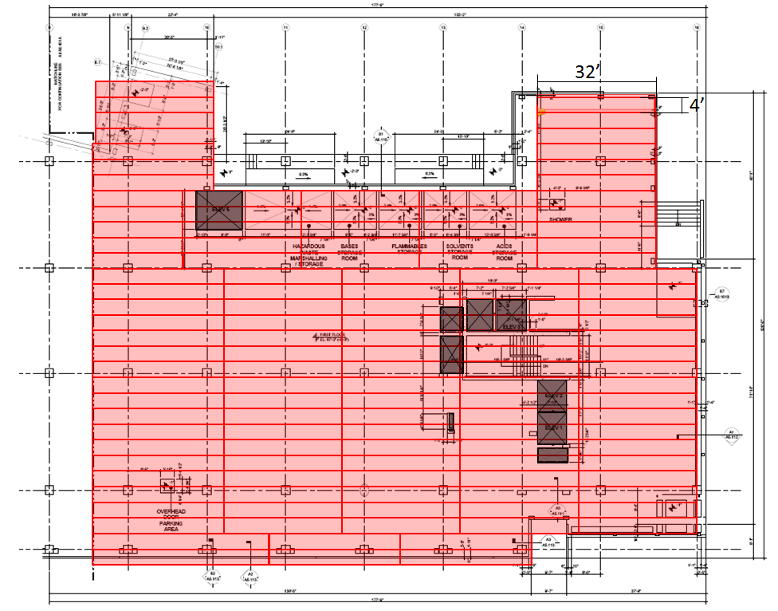
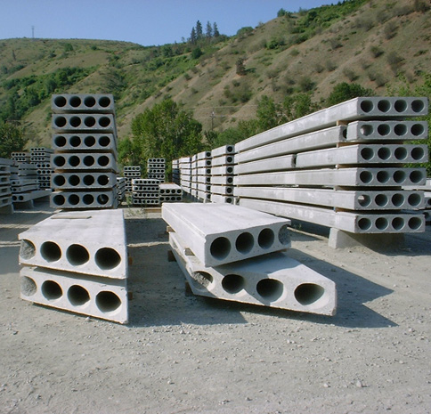
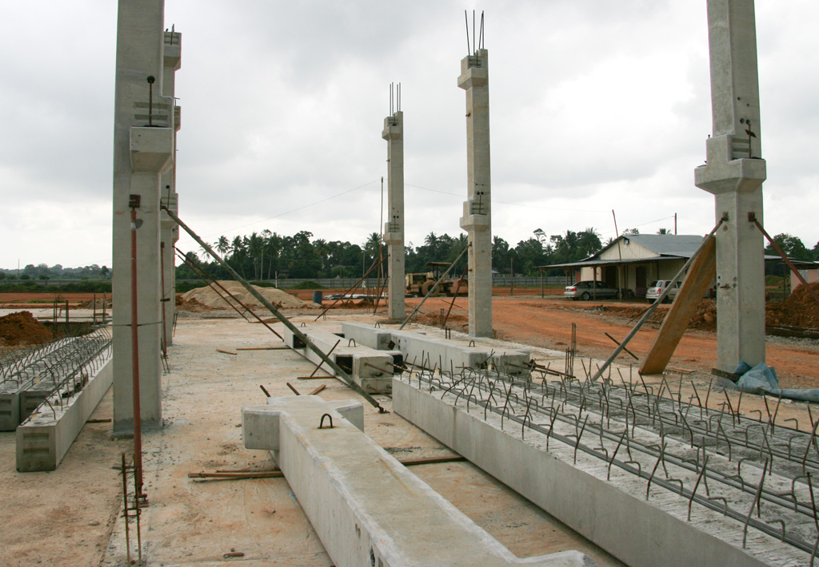
Outline
Precast Concrete System Overview
Structural System Breakdown
Introduction
Project Overview
Analysis #1: Precast Concrete Structural System
Precast Concrete System Overview
Structural System Breakdown
Sequencing
Schedule Impacts
Cost of System
Cost Analysis
Analysis #2: Virtual Mock-ups for Building Façade System
Analysis #3: Implementation of Alternate Dewatering System
Analysis #4: Value Engineering Stormwater Harvesting System
Conclusion & Recommendations
Acknowledgements
Questions
8” Hollowcore Plank Slab System with 2” topping
2 hour fire rating - IBC 2009 & NFPA Standard No. 1
Precast Concrete Structural Beams
Original steel reinforcement layout. (1-1/2”)
Precast Concrete Columns
Original steel reinforcement layout (Depends on concrete column)
Building Slab sectioned into plank dimensions 4’x32’ & 4’x36’
Cutting the slab necessary to meet irregular building perimeter.
Beams produced to match the beam schedule provided.
Long beams were divided into parts
Columns produced combining multiple columns within column schedule
54’ in height max.
(necessary for delivery
and erection)
Splicing occurs at slab
connections.

Slide 6
Outline
Sequencing
Schedule Impact
Introduction
Project Overview
Analysis #1: Precast Concrete Structural System
Precast Concrete System Overview
Structural System Breakdown
Sequencing
Schedule Impacts
Cost of System
Cost Analysis
Analysis #2: Virtual Mock-ups for Building Façade System
Analysis #3: Implementation of Alternate Dewatering System
Analysis #4: Value Engineering Stormwater Harvesting System
Conclusion & Recommendations
Acknowledgements
Questions
PRECAST STRUCTURAL SYSTEM PRODUCTION DURATION
Structural Member | Quantity | Production Rate | Production Duration
Hollow Core Planks | 665 | 3/days | 222 days
Beams/Columns | 1833 | 50/day | 36.75 days
Beams/columns and hollow core planks produced simultaneously.
Total Production Duration: 222 days
75% of production complete before installation. (Begin June 25, 2011)
Construction
Columns erected by column lines from west to east and from north to south.
Beam erection
Connect to beams by grouting them to hunches.
Hollow core plank installation
Place shoring during lifts.
PRECAST STRUCTURAL SYSTEM ERECTION DURATION
Structural Member | # of Members | Erection Rate | Erection Duration
Beams/Columns | 665 | 30 min./member | 41.6 days
Hollow Core Planks | 1833 | 10 min./member | 38.2 days
TOTAL DURATION |  |  | 79.8 ~ 80 days
Structural Members grouted and connected between picks.
Hoist block remains the same, do not need to account for additional time.
Original Baseline Schedule: 97 work days
Potential Schedule Savings: 17 days (3.4 weeks)

Slide 7
Outline
Cost of System
Cost Analysis
Introduction
Project Overview
Analysis #1: Precast Concrete Structural System
Precast Concrete System Overview
Structural System Breakdown
Sequencing
Schedule Impact
Cost of System
Cost Analysis
Analysis #2: Virtual Mock-ups for Building Façade System
Analysis #3: Implementation of Alternate Dewatering System
Analysis #4: Value Engineering Stormwater Harvesting System
Conclusion & Recommendations
Acknowledgements
Questions
Cost for the Precast System were estimated by Nitterhouse Concrete Products pricings and RSMeans Assemblies Cost Data.
Vendors Pricing:
Hollow core planks - $8.00/ S.F.
Columns - $140/ L.F.
Beams - $155/ L.F.
TOTAL SYSTEM COSTS (based on source)
Original Design – Cast in Place
Jacobs Cost Estimate | $7,168,807
Turner Pay Application | $6,835,598
Proposed Design – Precast Concrete
Precast System Cost | $6,300,000
PRECAST SYSTEM COST ESTIMATES
Vendor Cost Estimate | $5,425,087
RSMeans Estimate | $7,793,203
Adjusted Estimate | $6,300,000
Cost Savings: $535,598
*Adjusted estimate accounts for lack of specifications in RSMeans and lack of materials in lump sum vendor price. Also takes into account crane sizing upgrade.

Slide 8
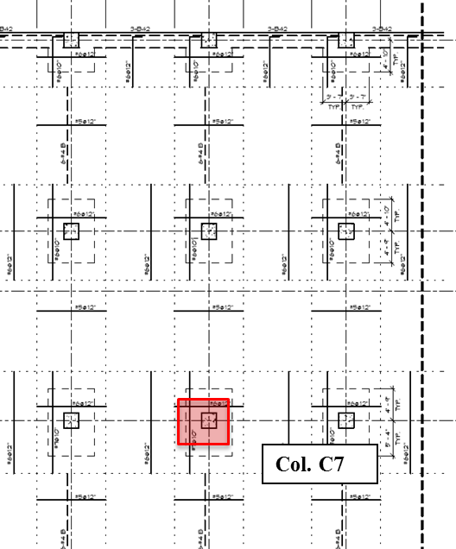
Outline
Structural Analysis
Introduction
Project Overview
Analysis #1: Precast Concrete Structural System
Structural Breadth Analysis – Punching Shear and Slab Strength
Analysis #2: Virtual Mock-ups for Building Façade System
Analysis #3: Implementation of Alternate Dewatering System
Analysis #4: Value Engineering Stormwater Harvesting System
Conclusion & Recommendations
Acknowledgements
Questions
Interior Column Punching Shear
Precast System eliminates drop panels at columns.
Stronger concrete used in precast system (6000 psi)
Calculated Shear Load at Column: 984 psf
Calculated Shear Strength: 1416 psf
V_{c} ≥ V_{u} , therefor
adequate design
Hollow Core Slab Strength
Criteria for allowable superimposed load and plank span (feet).
HDR, Inc. calculated live load of typical floor = 125 psf
Increased Schedule because of reduced span.
Additional approximated 6 days added to erection.
No Additional Costs because cost based on square footage.

Slide 9
Analysis #2: Virtual Mock-ups for Building Façade System

Slide 10
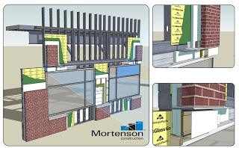
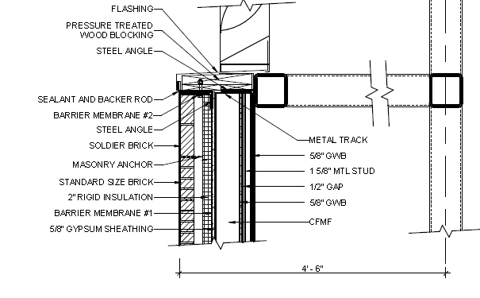
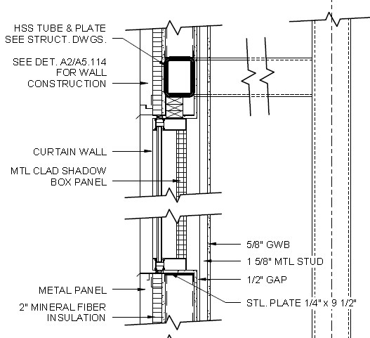
Outline
Virtual Mock-Up Overview
Quality & Safety Improvements
Introduction
Project Overview
Analysis #1: Precast Concrete Structural System
Analysis #2: Virtual Mock-ups for Building Façade System
Virtual Mock-Up Overview
Quality & Safety Improvements
Schedule Impact
Cost Analysis
Analysis #3: Implementation of Alternate Dewatering System
Analysis #4: Value Engineering Stormwater Harvesting System
Conclusion & Recommendations
Acknowledgements
Questions
Create Virtual Mock-ups for building envelop.
Detail connections to superstructure and to other façade systems.
Façade systems includes:
Curtain wall
Metal Panels
Brick Veneer
Shop Window
Quality significantly increases when performing the tasks.
Subcontractors can easily understand the work to be performed and how to effectively complete the work.
Better understanding how to complete the task effectively reduces risks and potential safety hazards.

Slide 11
Outline
Schedule Impact
Cost Analysis
Introduction
Project Overview
Analysis #1: Precast Concrete Structural System
Analysis #2: Virtual Mock-ups for Building Façade System
Virtual Mock-up Overview
Quality & Safety Improvements
Schedule Impact
Cost Analysis
Analysis #3: Implementation of Alternate Dewatering System
Analysis #4: Value Engineering Stormwater Harvesting System
Conclusion & Recommendations
Acknowledgements
Questions
Time to create mock-ups: 2-3 weeks
The time creating the mock-ups should occur around Dec. 8, 2011.
Time Savings: 2-4 days
Based on Greenfield Hospital Case Study. (2.5 weeks)
35% of building schedule
Cost to create mock-ups: $3,000 - $9,840
$3,000 - $4,000 provided by Mortenson Construction
$3,280 – $9,840 based on $82 an hour working on models.
Associated Cost Savings: approx. $94,710
Reduction of system change orders by 50%
Efficiency savings of 0.3%. (based off 17% of project)
PROJECT COST SAVINGS: $84,870 - $91,710

Slide 12
Analysis #3: Implementation of Alternate Dewatering System

Slide 13
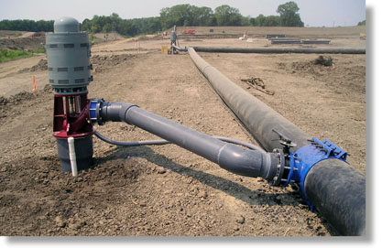
Outline
System Selection
System Sizing
Introduction
Project Overview
Analysis #1: Precast Concrete Structural System
Analysis #2: Virtual Mock-ups for Building Façade System
Analysis #3: Implementation of Alternate Dewatering System
System Selection
System Sizing
System Mapping
Installation & Scheduling Durations
System Cost
Cost Analysis
Analysis #4: Value Engineering Stormwater Harvesting System
Conclusion & Recommendations
Acknowledgements
Questions
Geotechnical Report Indicates clay and sandy soils.
Groundwater table apparent at 18’ depth from surface.
Confined project boundaries.
Existing Utilities
Deep Wells
Useful for depth greater
15’.
Used in confined areas
Adequate effectiveness
with low permeable
soils
Size depends on these major aspect:
Site Excavation Dimensions (308’x 96’)
Groundwater Table Depth (approx. 18’)
Impervious Layer Depth (approx. 70’)
Flow Rate Calculations and System Sizes
Total Necessary Flow – 0.1793 m³/s
Number of Wells – 7 deep wells
Well Casings/Screens Sizing – 12” diameter
Pump Size- 6”

Slide 14
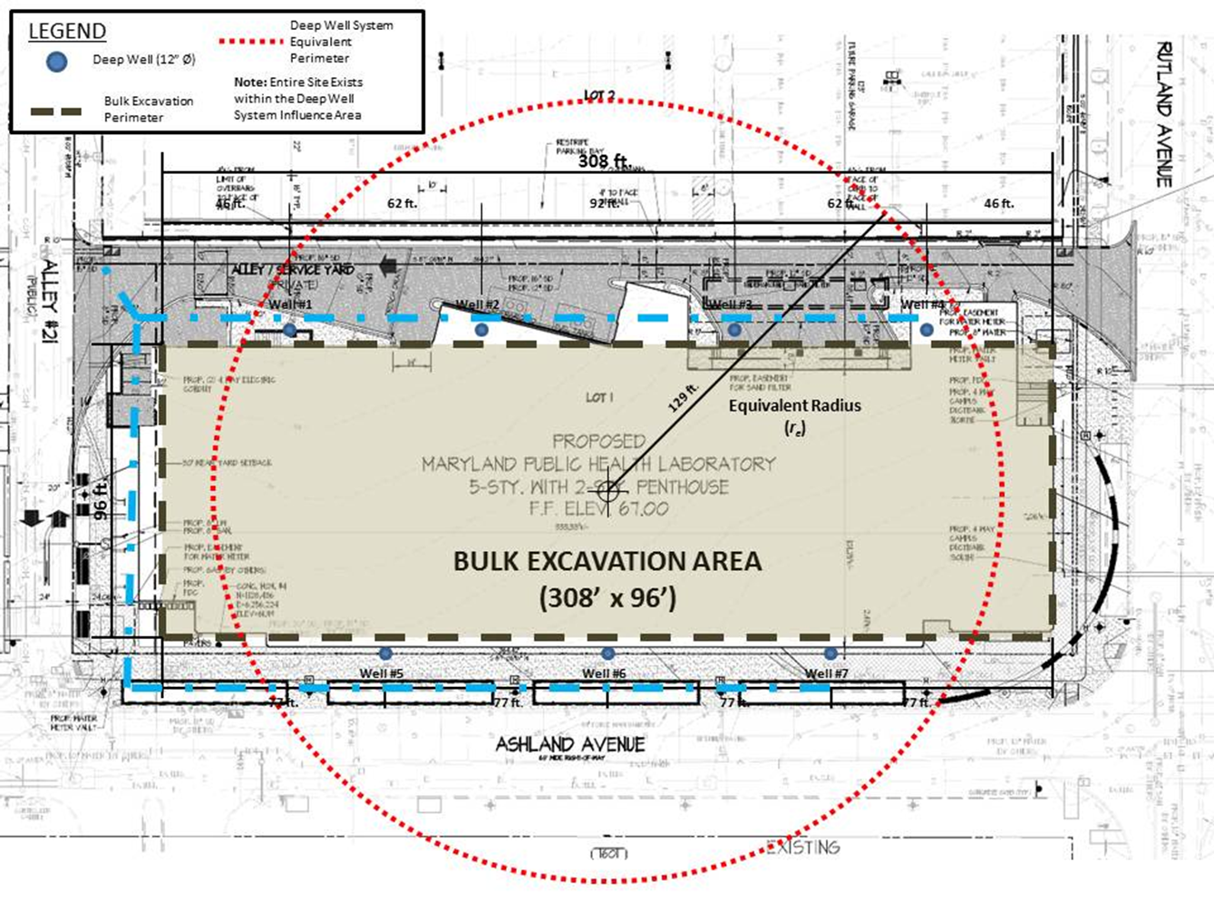
Outline
System Mapping
Installation & Scheduling Durations
Introduction
Project Overview
Analysis #1: Precast Concrete Structural System
Analysis #2: Virtual Mock-ups for Building Façade System
Analysis #3: Implementation of Alternate Dewatering System
System Selection
System Sizing
System Mapping
Installation & Scheduling Durations
System Cost
Cost Analysis
Analysis #4: Value Engineering Stormwater Harvesting System
Conclusion & Recommendations
Acknowledgements
Questions
Use Forchheimer’s equation to place single spot wells and achieve adequate necessary . $Q= \frac{πk(H^{2}−{h_{w}}^{2})}{\ln{R_{0}}−\left(\frac{1}{N−1}\right)\ln{(x_{1}x_{2}x_{3}….x_{n})}}$
DEEP WELL INSTALLATION DURATION
Drilling Deep Wells | 7 wells | 2 well/day | 3.5 days
Pump Equipment Installation | 7 wells | 15 min/ well | 1 hr. 45 min.
Discharge Pipe Installation | 612 ft. | 400 ft./day | 1.53 days
TOTAL DEWATERING INSTALLATION DURATION |  |  | 5.25 days
Installation occurs as excavation begins, Feb. 27, 2012.
The system will run until all tasks below ground water table are complete (expected 143 days)
System demobilization takes 2-3 days.
Total system duration is 150 days.
Dewatering system doesn’t installation doesn’t affect critical path, but will save the lost 2 months due to flooding.

Slide 15
Outline
System Cost
Cost Analysis
Introduction
Project Overview
Analysis #1: Precast Concrete Structural System
Analysis #2: Virtual Mock-ups for Building Façade System
Analysis #3: Implementation of Alternate Dewatering System
System Selection
System Sizing
System Mapping
Installation & Scheduling Durations
System Cost
Cost Analysis
Analysis #4: Value Engineering Stormwater Harvesting System
Conclusion & Recommendations
Acknowledgements
Questions
DEEP WELL SYSTEM COST
Equipment | $52,262
Materials | $3,665
Rental/Operational Rates | $53,700
Dewatering Cost | $8,400
Labor | $247,988
Overhead | $2,400
TOTAL COST | $390,596
Total Cost of Deep Well System: $390,596
Cost of Original Dewatering System: $185,000
Total Dewatering Cost with Change Orders: $770,381
Turners Projected Productivity Loss: $1.8 million
Total Cost Savings of System: $1.4 million

Slide 16
Analysis #4: Value Engineering Stormwater Harvesting System

Slide 17
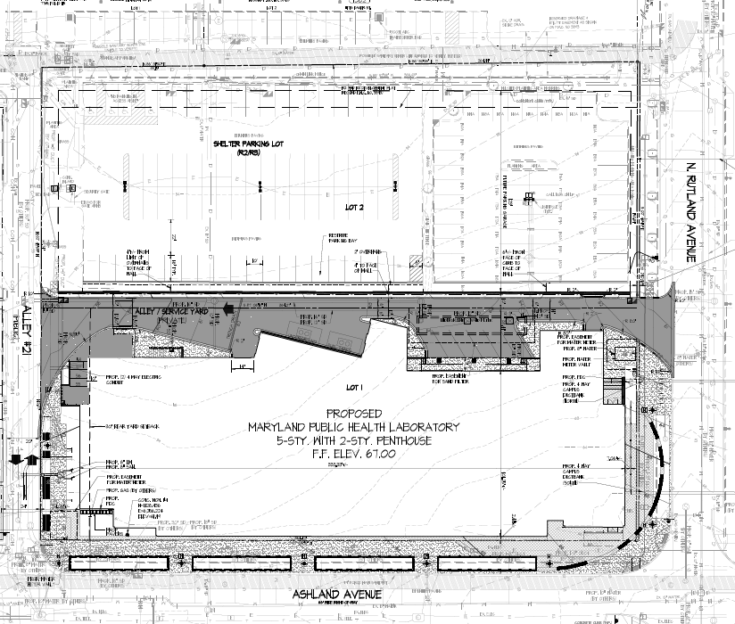
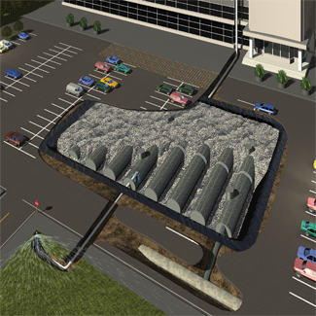
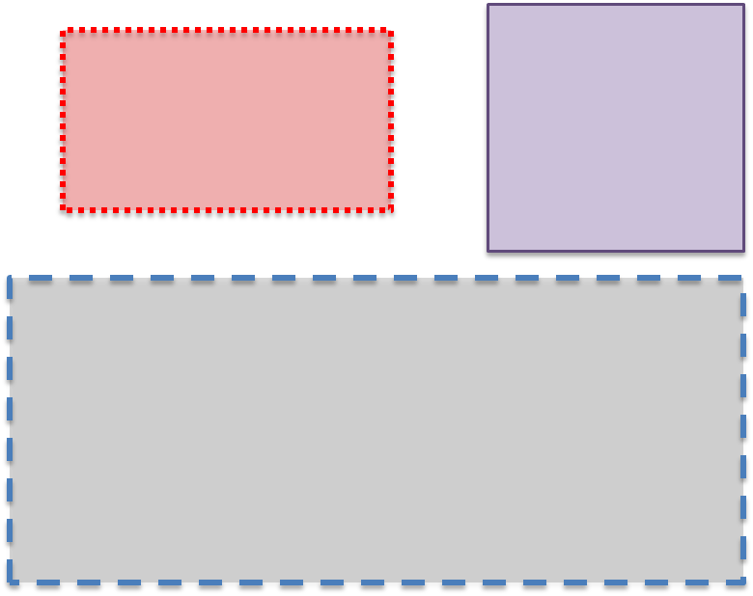
Outline
System Overview
Proposed Installation Area
Introduction
Project Overview
Analysis #1: Precast Concrete Structural System
Analysis #2: Virtual Mock-ups for Building Façade System
Analysis #3: Implementation of Alternate Dewatering System
Analysis #4: Value Engineering Stormwater Harvesting System
System Overview
Proposed Installation Area
Cost Savings
Cost of Installation
Cost Analysis
Sustainability Evaluation
Conclusion & Recommendations
Acknowledgements
Questions
5 Underground Metal Cisterns that will hold roughly 250,000 gallons of stormwater runoff.
8’ diameter cisterns.
Will store potential grey water, roof run-off water and hardscape run-off water.
Prefiltration and pump manhole placed within excavated installation area.
Excavation Dimensions: 160’ x 85’

Slide 18
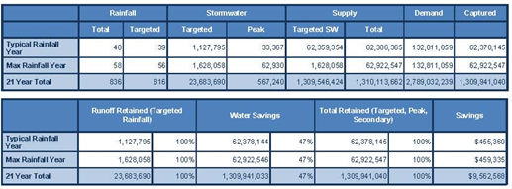
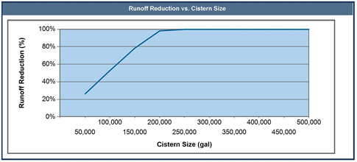
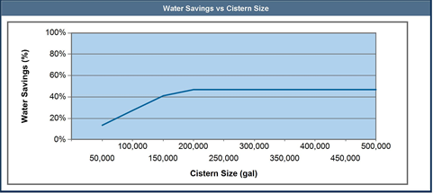
Outline
Cost Savings
Cost of Installation
Introduction
Project Overview
Analysis #1: Precast Concrete Structural System
Analysis #2: Virtual Mock-ups for Building Façade System
Analysis #3: Implementation of Alternate Dewatering System
Analysis #4: Value Engineering Stormwater Harvesting System
System Overview
Proposed Installation Area
Cost Savings
Cost of Installation
Cost Analysis
Sustainability Evaluation
Conclusion & Recommendations
Acknowledgements
Questions
STORMWATER HARVESTING SYSTEM INSTALLATION COST
Demolition | $22,238
Earthwork | $210,416
System Installation Fee | $113,000
Stormwater Harvesting Equipment | $500,725
Site Improvement | $176,500
TOTAL STORMWATER HARVESTING COST | $1,999,379

Slide 19
Outline
Cost Analysis
Sustainability Evaluation
Introduction
Project Overview
Analysis #1: Precast Concrete Structural System
Analysis #2: Virtual Mock-ups for Building Façade System
Analysis #3: Implementation of Alternate Dewatering System
Analysis #4: Value Engineering Stormwater Harvesting System
System Overview
Proposed Installation Area
Cost Savings
Cost of Installation
Cost Analysis
Sustainability Evaluation
Conclusion & Recommendations
Acknowledgements
Questions
Potential Cost Savings:
Annual Savings with Typical Rainfall: $455,360
Annual Savings with Max. Rainfall: $459,335
21 Year Total Cost Savings: $9,562,568
Total Cost of Stormwater Harvesting System: approx. $2 million
Pay off Period: 4.5 Years
Water Efficiency
Innovative Wastewater Technologies (0 out of 2 points)
1.) Reduce potable water for sewage by 50%. UNATTAINABLE
2.) Treat 50% of wastewater onsite. UNATTAINABLE
Water Use Reduction (2 out of 4 points)
1.) Reduce water consumption to 40%. UNATTAINABLE
Waster Reduction Percentage: 2.23% (Total of 33.23%)

Slide 20
Outline
Conclusion & Recommendations
Introduction
Project Overview
Analysis #1: Precast Concrete Structural System
Analysis #2: Virtual Mock-ups for Building Façade System
Analysis #3: Implementation of Alternate Dewatering System
Analysis #4: Value Engineering Stormwater Harvesting System
Conclusion & Recommendations
Acknowledgements
Questions
Analysis #1: Precast Concrete Structural System
COST SAVINGS: $535,598
SCHEDULE SAVINGS: 2 weeks
INCREASED SAFETY
Analysis #2: Virtual Mock-ups for Building Façade Systems
COST SAVINGS: $84,870 - $91,710
SCHEDULE SAVINGS: 2-4 days
INCREASED PRODUCT QUALITY
SAFTEY SAFETY

Slide 21
Outline
Conclusion & Recommendations
Introduction
Project Overview
Analysis #1: Precast Concrete Structural System
Analysis #2: Virtual Mock-ups for Building Façade System
Analysis #3: Implementation of Alternate Dewatering System
Analysis #4: Value Engineering Stormwater Harvesting System
Conclusion & Recommendations
Acknowledgements
Questions
Analysis #3: Implementation of Alternate Dewatering System
COST SAVINGS: $1,400,000
SCHEDULE SAVINGS: 2 months
NO MATERIAL AND PROPERTY DAMAGE
Analysis #4 Value Engineering Stormwater Harvesting System
COST OF INSTALLATION: $2,000,000
ANNUAL COST SAVINGS: $455,000
PAY OFF PERIOD: 4.5 years
ADDITIONAL WORK DURATION: 1.5 months
NO LEED POINTS ABLE TO BE ACQUIRED

Slide 22
Academic Acknowledgments
Penn State Architectural Engineering Faculty
Dr. Robert Leicht – CM Thesis Advisor
Industry Acknowledgments
Jacobs Engineering
Turner Construction Company
HDR, Inc.
Special Thanks
Ahmad Hamid – Jacobs Engineering
Brian Temme – Jacobs Engineering
Thomas Stevenson – Jacobs Engineering
Grace Wang – Jacobs Engineering
Dana Rumpulla – Turner Construction Co.
Corretta Bennett – Turner Construction Co.
Justin Beaver – Griffin Dewatering Co.
Andreas Phelps – Balfour Beatty
Mitch Cormelius – Mortenson Construction Co.
Reno Russell – Bigge Crane and Rigging Co.
Joe Hockberger – Mersino Dewatering
Jordan Kahlenberg – Contech Engineering Solutions
Ken Dombroski – Contech Engineering Solutions

Slide 23
QUESTIONS

